Slide 1

Charlottesville Community Hospital
Charlottesville, Virginia
Joe Bonacci – Construction
Advisor: Dr. Robert Leicht

Slide 2

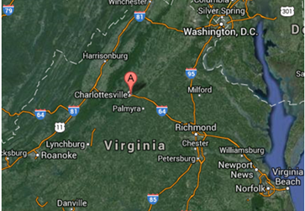

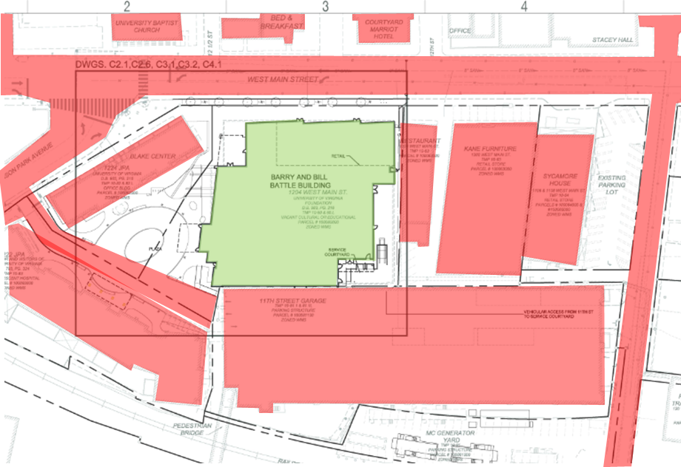

Charlottesville Community Hospital
Charlottesville, Virginia
Project Overview
Joe Bonacci - Construction
I. Project Overview
II. Analysis #1 – Prefabricated Bricks
- Mechanical Breadth
III. Analysis #2 – Rooftop Wind Turbines
- Electrical Breadth
IV. Analysis #3 – Material Storage Hub
V. Conclusions
- Acknowledgements
Project Information
Project Cost: $141.6 million
Duration: 04/01/11 – 06/01/14
Location: Charlottesville, VA
Building Function
This children's hospital is meant to centralize pediatric care into one building so that parents and visitors do not need to travel to multiple sites.
Site Logistics
Congested Job Site
Neighboring buildings to protect
Pedestrian Sidewalk protection needed
Building Structure
7 Above Grade Floors
200,000 Gross SF
Cast–In–Place Concrete
Structural Steel Penthouse

Slide 3



Charlottesville Community Hospital
Charlottesville, Virginia
Prefabricated Brick Panels
Joe Bonacci - Construction
I. Project Overview
II. Analysis #1 – Prefabricated Bricks
- Mechanical Breadth
III. Analysis #2 – Rooftop Wind Turbines
- Electrical Breadth
IV. Analysis #3 – Material Storage Hub
V. Conclusions
- Acknowledgements
Problem Identification
Site scaffolding and mortar mixing supplies create safety hazards and building entry obstructions for workers
The limited site laydown space is taken up by masons for 22% of the project’s duration.
Proposed Solution
Substitute traditional brick assembly with prefabricated brick panels.
Eliminate need for scaffolding and hydraulic lift
Decrease safety risks associated with brick construction
Panel Information
6” thick (5 3/8” concrete, 5/8” thin brick)
Additional insulation required on interior
Maximum width: 12’
Maximum Length: 15’
Panels will be installed vertically to span from floor to floor
Joints are sealed with specified caulking

Slide 4
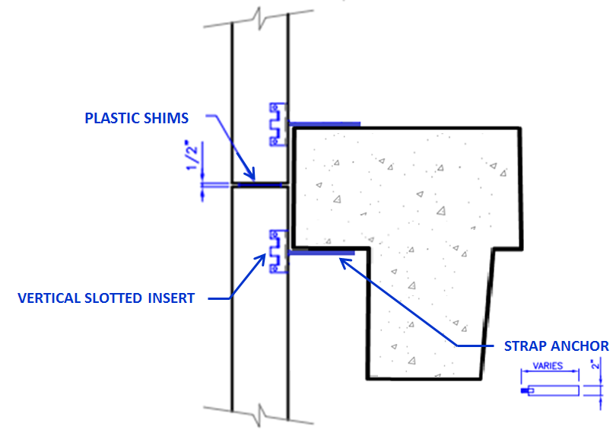
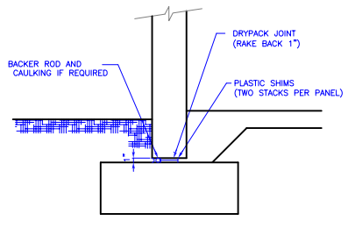
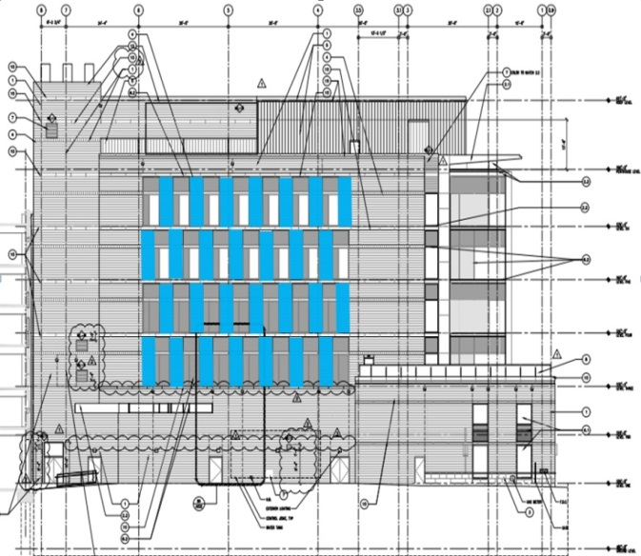
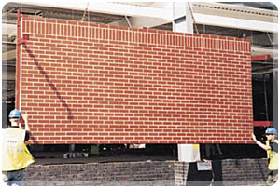
Charlottesville Community Hospital
Charlottesville, Virginia
Prefabricated Brick Panels
Joe Bonacci - Construction
West Facade
North Facade
East Facade
South Facade
I. Project Overview
II. Analysis #1 – Prefabricated Bricks
- Mechanical Breadth
III. Analysis #2 – Rooftop Wind Turbines
- Electrical Breadth
IV. Analysis #3 – Material Storage Hub
V. Conclusions
- Acknowledgements
Connection Details
*24,417 SF of Brick
*24 window panels

Slide 5
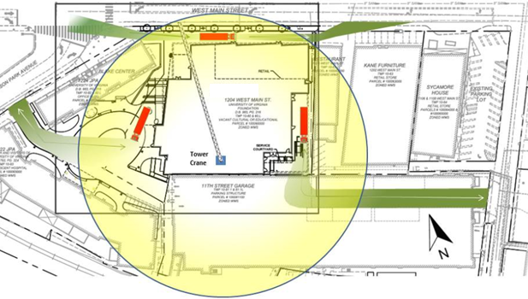
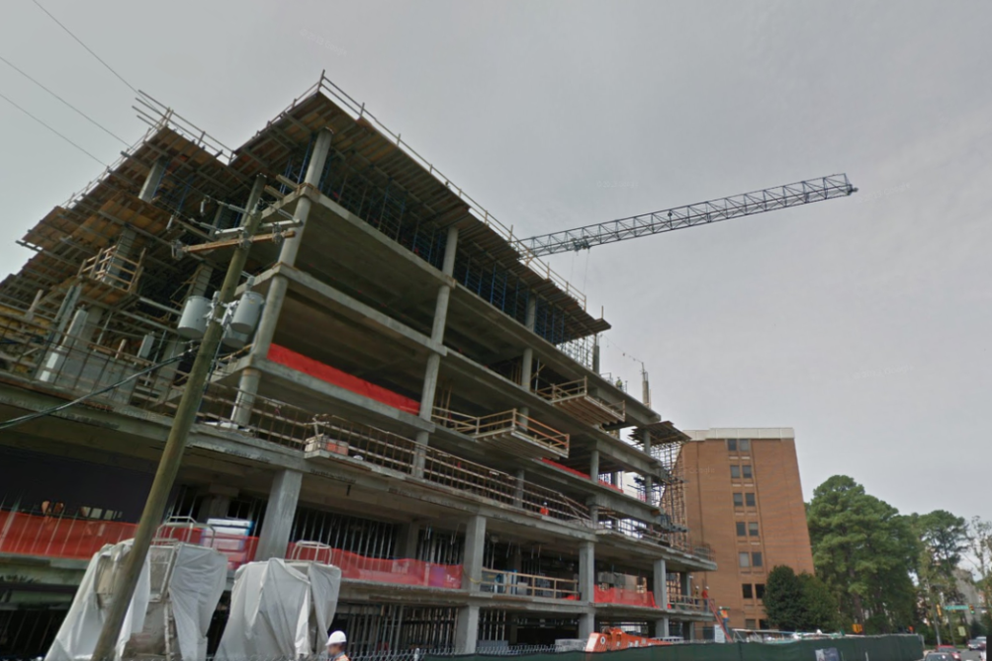
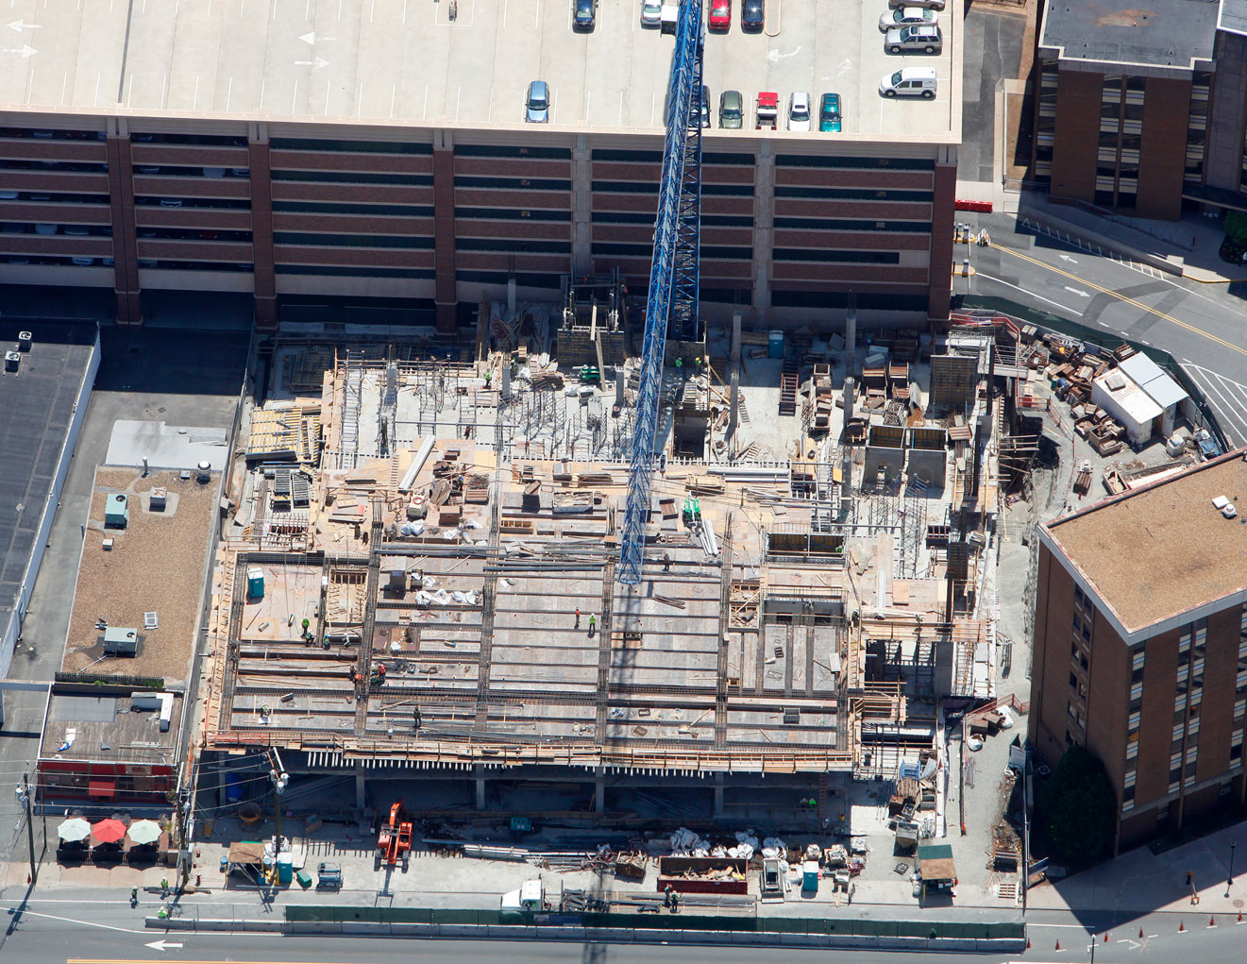
Charlottesville Community Hospital
Charlottesville, Virginia
Prefabricated Brick Panels
Joe Bonacci - Construction
I. Project Overview
II. Analysis #1 – Prefabricated Bricks
- Mechanical Breadth
III. Analysis #2 – Rooftop Wind Turbines
- Electrical Breadth
IV. Analysis #3 – Material Storage Hub
V. Conclusions
- Acknowledgements
Heaviest Panel: 13,500 lbs.
Crane Capacity: 39,680 lbs.

Slide 6
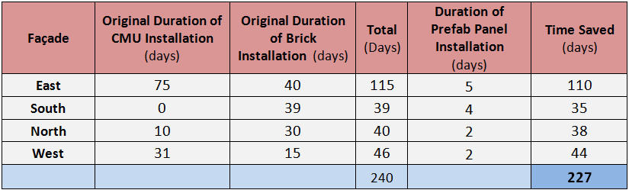
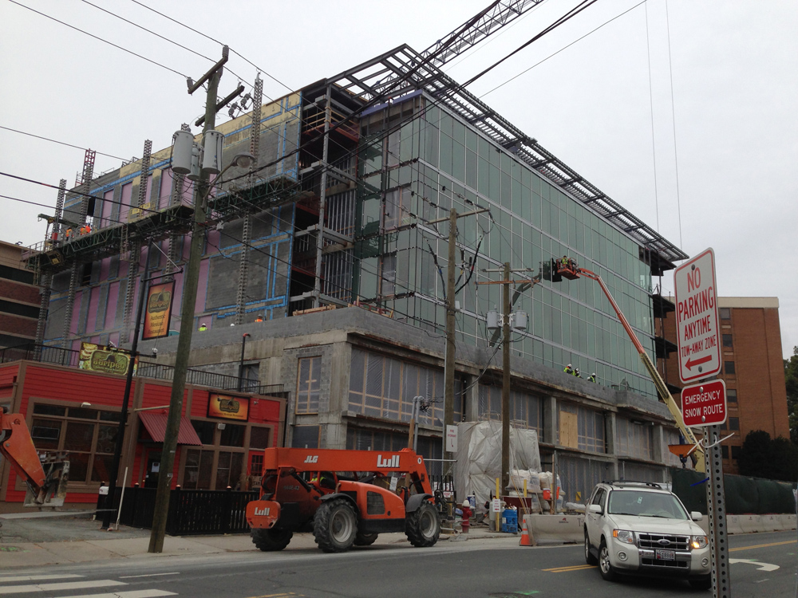
Charlottesville Community Hospital
Charlottesville, Virginia
Prefabricated Brick Panels
Joe Bonacci - Construction
I. Project Overview
II. Analysis #1 – Prefabricated Bricks
- Mechanical Breadth
III. Analysis #2 – Rooftop Wind Turbines
- Electrical Breadth
IV. Analysis #3 – Material Storage Hub
V. Conclusions
- Acknowledgements
Cost Analysis
Schedule Analysis
Total Cost of Traditional Method: $755,773
Total Cost of Prefabricated Panels: $1,001,585
General Conditions Savings: $38,232

Slide 7
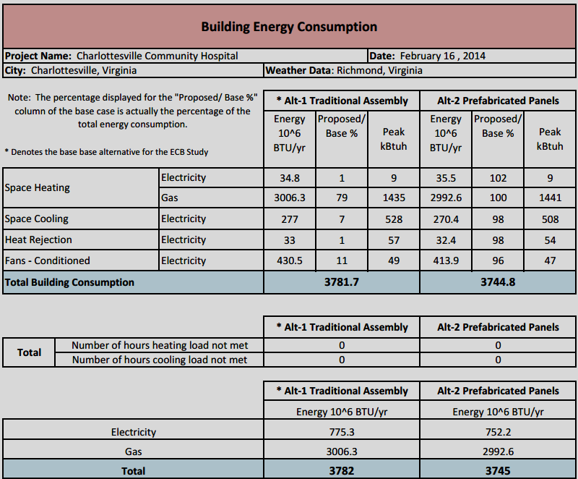
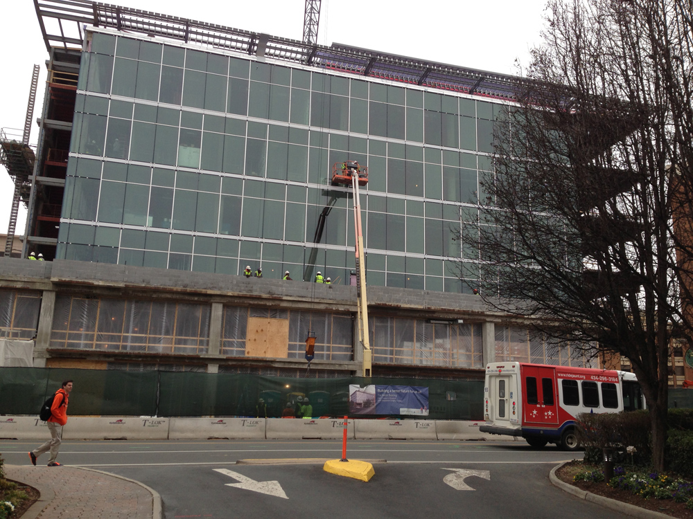
Charlottesville Community Hospital
Charlottesville, Virginia
Energy Comparison
Joe Bonacci - Construction
I. Project Overview
II. Analysis #1 – Prefabricated Bricks
- Mechanical Breadth
III. Analysis #2 – Rooftop Wind Turbines
- Electrical Breadth
IV. Analysis #3 – Material Storage Hub
V. Conclusions
- Acknowledgements
Results
Additional Cost: $207,600
All panels can be installed in 13 days
Eliminate scaffolding and construction debris for 227 days.

Slide 8
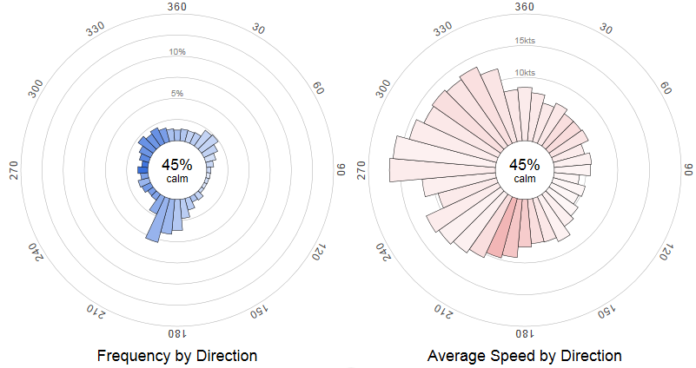


Charlottesville Community Hospital
Charlottesville, Virginia
Rooftop Wind Turbines
Joe Bonacci - Construction
I. Project Overview
II. Analysis #1 – Prefabricated Bricks
- Mechanical Breadth
III. Analysis #2 – Rooftop Wind Turbines
- Electrical Breadth
IV. Analysis #3 – Material Storage Hub
V. Conclusions
- Acknowledgements
Problem Identification
There is a great deal of electricity needed to power the building
A renewable power source may contribute to the project teams goal of a LEED Gold Certification.
Proposed Solution
Wind turbines will be installed on the penthouse roof.
Electricity generated will be fed directly into MDP

Slide 9
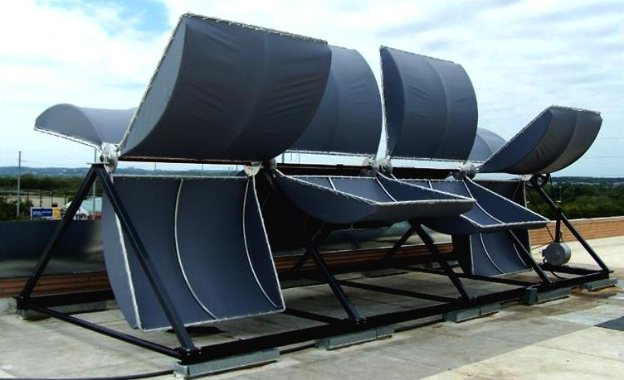
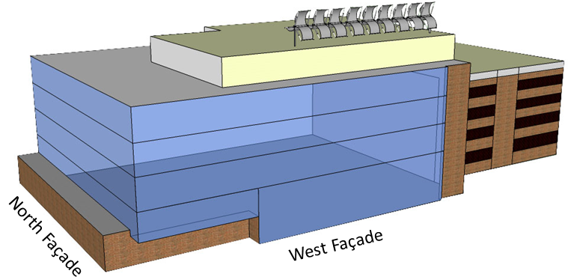
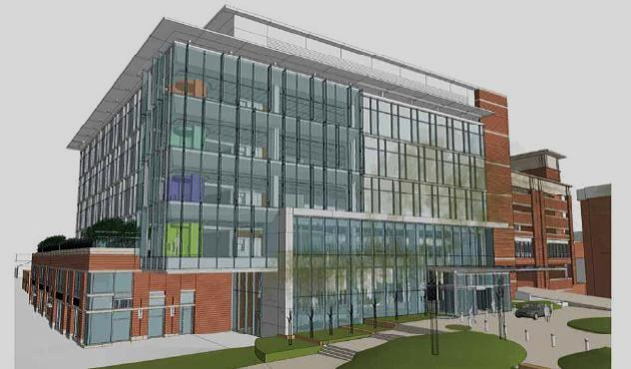
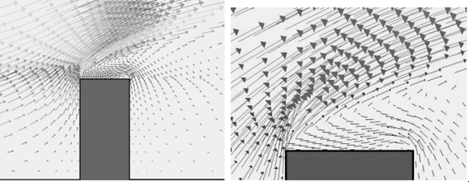
Charlottesville Community Hospital
Charlottesville, Virginia
Rooftop Wind Turbines
Joe Bonacci - Construction
I. Project Overview
II. Analysis #1 – Prefabricated Bricks
- Mechanical Breadth
III. Analysis #2 – Rooftop Wind Turbines
- Electrical Breadth
IV. Analysis #3 – Material Storage Hub
V. Conclusions
- Acknowledgements
Constructability
Crane used to lift material into place
Roof surface is TPO roof, rigid insulation, 1.5” roof deck
Weight: 1400 lbs.
Material: Canvas Structure: Steel Tubing
10’
27.5’
Wind Velocity Vectors
Notes:
A structural analysis was not conducted. It is assumed that the roof system will be adequate to support the turbines.

Slide 10
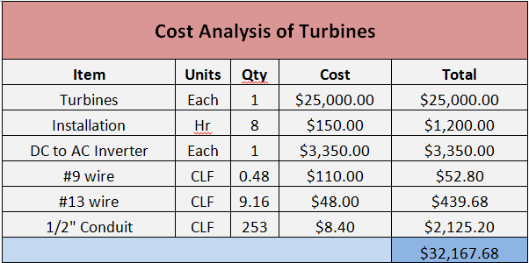
Charlottesville Community Hospital
Charlottesville, Virginia
Rooftop Wind Turbines
Joe Bonacci - Construction
I. Project Overview
II. Analysis #1 – Prefabricated Bricks
- Mechanical Breadth
III. Analysis #2 – Rooftop Wind Turbines
- Electrical Breadth
IV. Analysis #3 – Material Storage Hub
V. Conclusions
- Acknowledgements
Cost Analysis
Scheduling
Installed in 2 days
Lead time of 3 weeks
Should be installed between Feb. 1st – April 1st 2014
Notes:
No immediate need for turbines, must be installed after TPO roof is finished and before substantial completion.

Slide 11
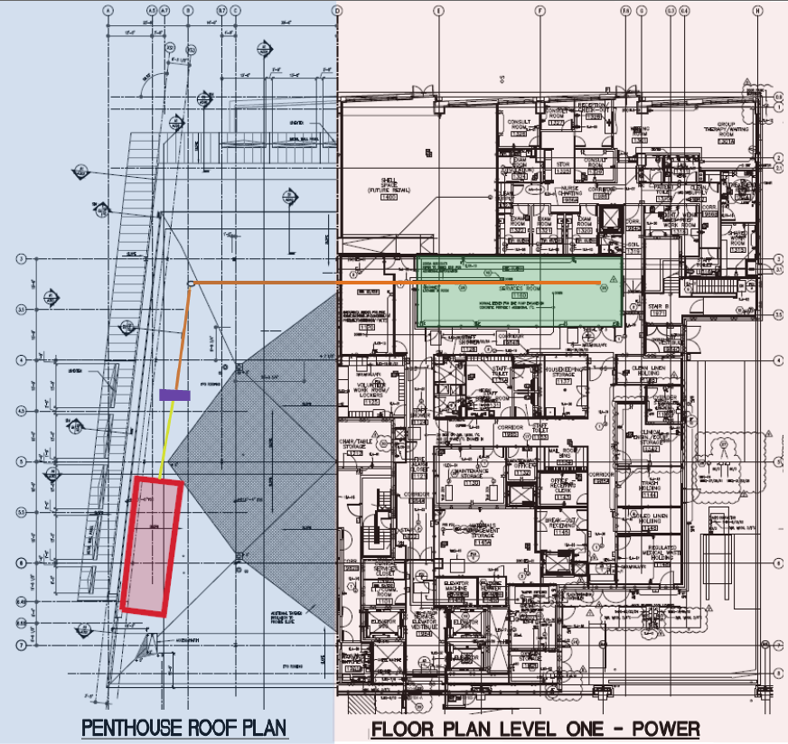
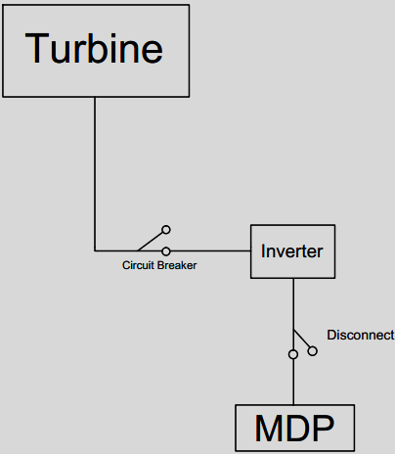
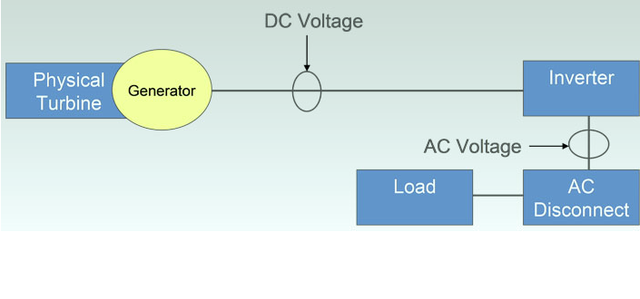
Charlottesville Community Hospital
Charlottesville, Virginia
Clean Energy Production
Joe Bonacci - Construction
I. Project Overview
II. Analysis #1 – Prefabricated Bricks
- Mechanical Breadth
III. Analysis #2 – Rooftop Wind Turbines
- Electrical Breadth
IV. Analysis #3 – Material Storage Hub
V. Conclusions
- Acknowledgements
Results
4kw Turbine * 24hrs/day * $0.0804/kWh = $7.72/day
$7.72/day * 365 days = $2817.8/year
*11.5 year payback period

Slide 12
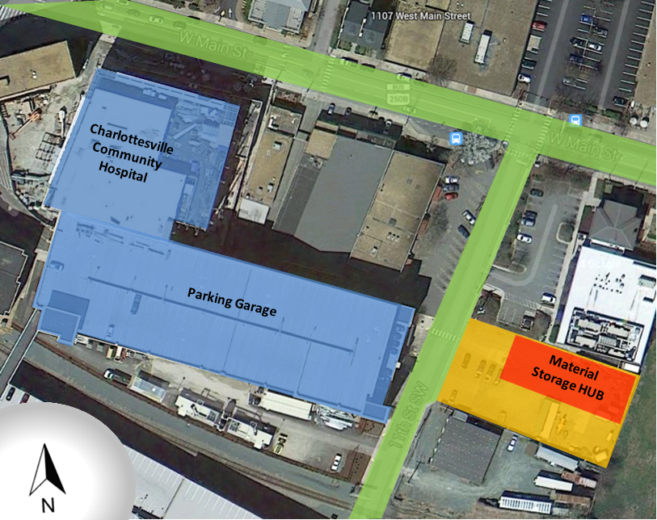
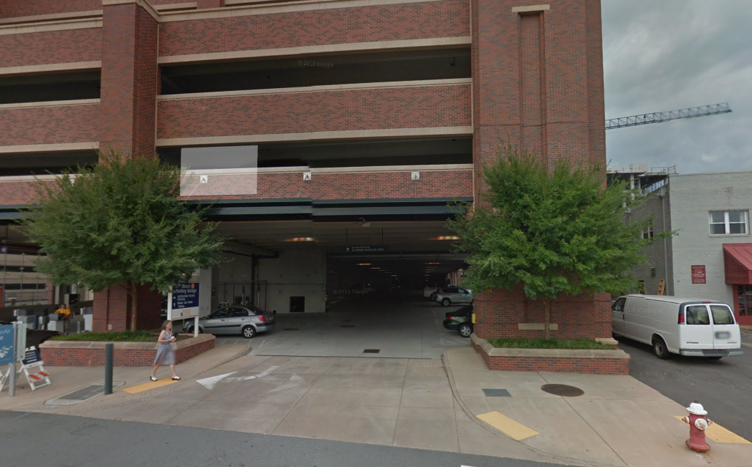
Charlottesville Community Hospital
Charlottesville, Virginia
Material Storage Hub
Joe Bonacci - Construction
Problem Identification
Frequent unscheduled deliveries make the loading lock and material hoist congested, which lowers productivity
GC is forced to pay for
Proposed Solution
Install temporary storage warehouse across from project entry.
Assign a manager who is in charge of accepting deliveries and coordinating with the projects superintendent for site deliveries.
Site logistics
I. Project Overview
II. Analysis #1 – Prefabricated Bricks
- Mechanical Breadth
III. Analysis #2 – Rooftop Wind Turbines
- Electrical Breadth
IV. Analysis #3 – Material Storage Hub
V. Conclusions
- Acknowledgements
Lot Footprint: 140’x70’
*Room to park and ..swing truck in
Garage height: 15’

Slide 13
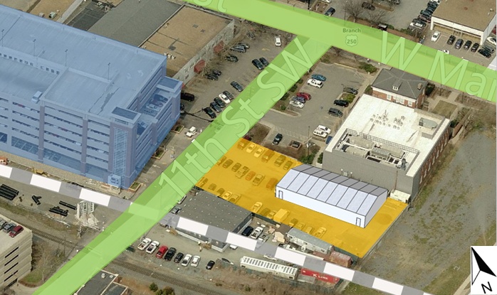
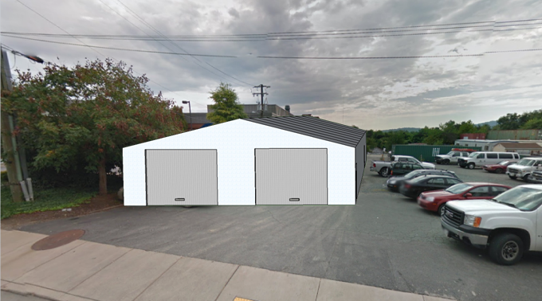

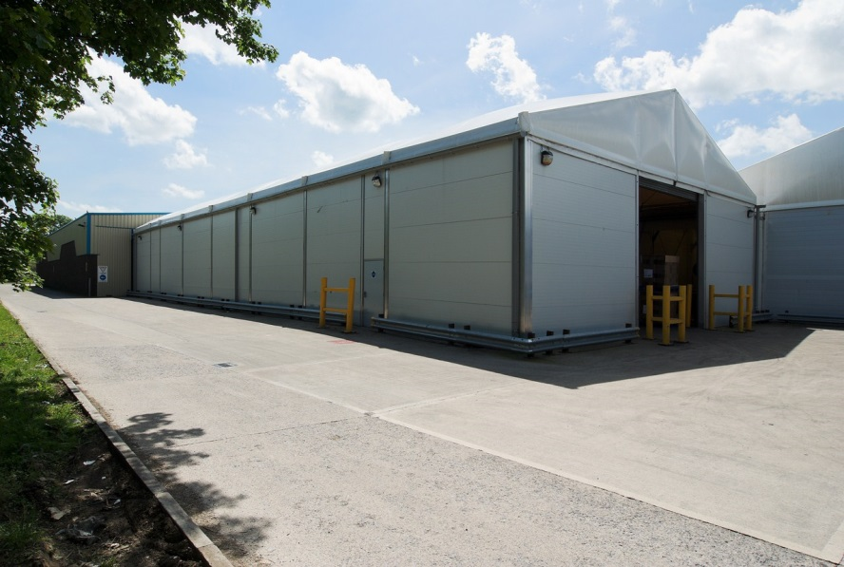
Charlottesville Community Hospital
Charlottesville, Virginia
Material Storage Hub
Joe Bonacci - Construction
I. Project Overview
II. Analysis #1 – Prefabricated Bricks
- Mechanical Breadth
III. Analysis #2 – Rooftop Wind Turbines
- Electrical Breadth
IV. Analysis #3 – Material Storage Hub
V. Conclusions
- Acknowledgements
Warehouse Structure
Building Details
Thermo-Insulated Modular Building
Eave height – 13’8”
Installed with small boom and hand tools
2 garage door bays for loading/unloading
2 man doors located at each end
Lead time: 4 weeks
Install time: 5 days
Building Footprint: 82’x40’
* 34% of lot space
* Remaining space for …contractor parking
Notes:
Need small boom truck or forklift.
Thermo insulated – To protect against warping of wood products and to reduce heating and cooling costs.

Slide 14
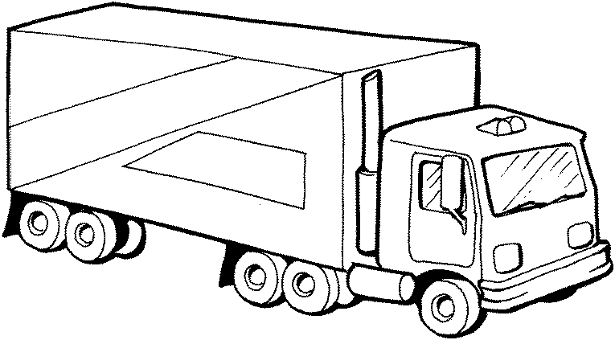
Charlottesville Community Hospital
Charlottesville, Virginia
Material Storage Hub
Joe Bonacci - Construction
Operation
I. Project Overview
II. Analysis #1 – Prefabricated Bricks
- Mechanical Breadth
III. Analysis #2 – Rooftop Wind Turbines
- Electrical Breadth
IV. Analysis #3 – Material Storage Hub
V. Conclusions
- Acknowledgements
Warehouse
Warehouse Manager
Superintendent
Loading Crew
Trades
Advantages
Contractors can order material earlier since there will always be a place to put them.
  Less chance of material delays
Lead times may become insignificant
Products may be able to be bought in bulk.
Material
Storage HUB
Project Loading Dock
Notes:
Talk about operation
Products bought in bulk can save money

Slide 15
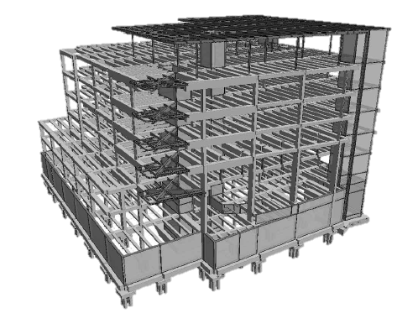
Charlottesville Community Hospital
Charlottesville, Virginia
Material Storage Hub
Joe Bonacci - Construction
I. Project Overview
II. Analysis #1 – Prefabricated Bricks
- Mechanical Breadth
III. Analysis #2 – Rooftop Wind Turbines
- Electrical Breadth
IV. Analysis #3 – Material Storage Hub
V. Conclusions
- Acknowledgements
Cost Analysis
Results
Added Costs: $570,000
Temporary warehouse exists for 24 months
Installation time: 5 days
Erection does not affect project schedule

Slide 16
Charlottesville Community Hospital
Charlottesville, Virginia
Conclusions
Joe Bonacci - Construction
I. Project Overview
II. Analysis #1 – Prefabricated Bricks
- Mechanical Breadth
III. Analysis #2 – Rooftop Wind Turbines
- Electrical Breadth
IV. Analysis #3 – Material Storage Hub
V. Conclusions
- Acknowledgements
Analysis #1 – Prefabricated Bricks
    Cost: $207,600
    Recommendation: Do Not Proceed
Analysis #2 – Rooftop Wind Turbines
    Cost: $32,168
    Recommendation: Proceed
Analysis #3 – Material Storage Hub
    Cost: $570,000
    Recommendation: Do Not Proceed
Notes:
Analysis #1: not recommended because of amount of windows and lack of uniformity, and higher costs.
Analysis #2: recommended because of low up front cost, architectural expression, and sustainable message.
Analysis #3: not recommended because of high initial cost. However the owner may believe that the positives outweigh costs.

Slide 17


Charlottesville Community Hospital
Charlottesville, Virginia
Acknowledgements
Joe Bonacci - Construction
I. Project Overview
II. Analysis #1 – Prefabricated Bricks
- Mechanical Breadth
III. Analysis #2 – Rooftop Wind Turbines
- Electrical Breadth
IV. Analysis #3 – Material Storage Hub
V. Conclusions
- Acknowledgements
Thank You to..
Dr. Robert Leicht
Dr. Susan Stewart
Adam Brown
Bob Stano
Billy Gamble

Slide 18
Thank You
Questions?

Slide 19
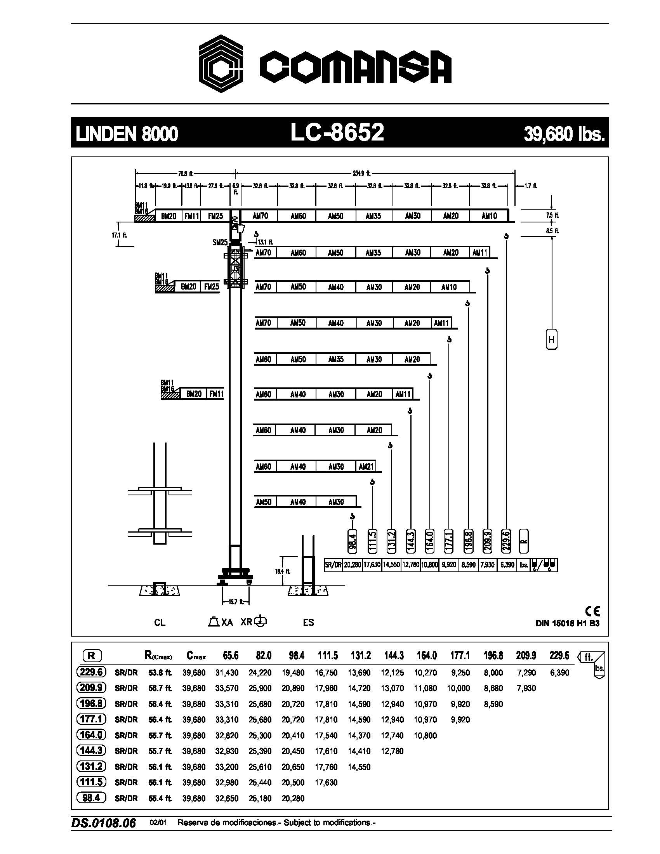
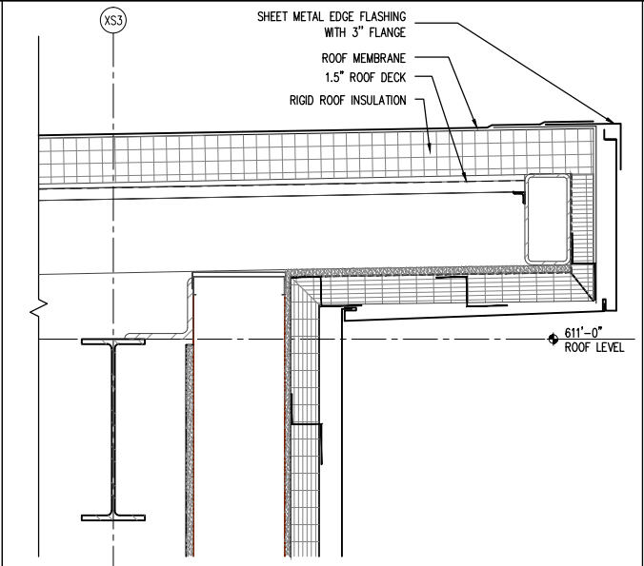
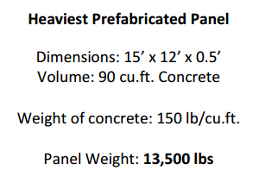
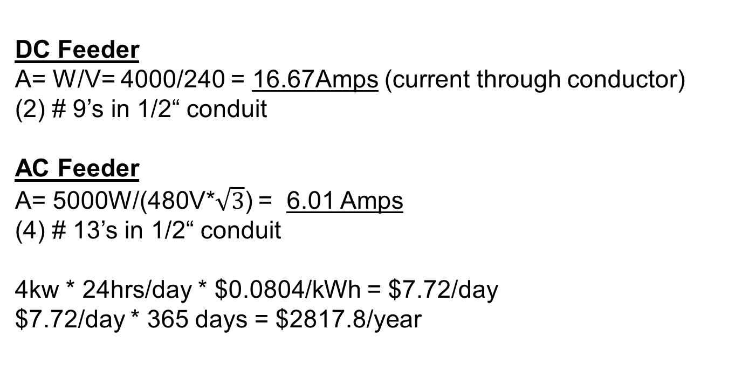
Charlottesville Community Hospital
Charlottesville, Virginia
Appendix
Joe Bonacci - Construction
DC Feeder
A= W/V= 4000/240 = 16.67Amps (current through conductor)
(2) # 9’s in 1/2“ conduit
AC Feeder
A= 5000W/(480V*$\sqrt{3}$) = 6.01 Amps
(4) # 13’s in 1/2“ conduit
4kw * 24hrs/day * $0.0804/kWh = $7.72/day
$7.72/day * 365 days = $2817.8/year

